Slide 1

Comparison Sorts
Optimizing selection sort, analyzing sorting algorithm stability, and quantifying sortedness.
Kevin Lin, with thanks to many others.
Notes:
Ask questions anonymously on Piazza. Look for the pinned Lecture Questions thread.

Slide 2
Feedback from the Reading Quiz
Trichotomy and Transitivity are properties for defining sorts.
Some data types do not have a well-defined sort.
Why sorting? Extremely common building block, exploration of algorithm design strategies.
373
417
143
373 > 374 or 373 < 374?
374

Slide 3
Performance Definitions
Time complexity. Characterizations of algorithm runtime efficiency.
Dijkstra’s has time complexity O(E log V).
Space complexity. Characterizations of added memory usage of an algorithm.
Dijkstra’s has space complexity Θ(V) for the fringe, distTo, and edgeTo.
Note that the graph takes up space Θ(V + E), but we don’t count this as part of the space complexity of Dijkstra since the graph itself already exists and is an input to Dijkstra’s.

Slide 4
Selection Sort
Demo
Selection sort. Repeatedly select the smallest remaining item and swap it to its proper index.
Find the smallest item in the array, and swap it with the first item.
Find the next smallest item in the array, and swap it with the next item.
Continue until all items in the array are sorted.
Θ(N²) time complexity.
Θ(1) space complexity.
We look through entire remaining array every time to find the minimum.

Slide 5
Naive Heapsort with a Max-Heap
Demo
Idea. Instead of rescanning entire array for min, maintain a heap so that finding min is fast!
Heapsort. Selection sort with a max-oriented heap–neat trick for saving memory later.
O(1). Create output array.
O(N log N). Insert all items into a new max-heap (separate array for the heap).
Repeat N times:
O(log N). Delete max item from the max-heap.
O(1). Put max item at the end of the unused part of the output array.
O(N log N) time complexity.
Θ(N) space complexity to create Θ(N) separate array heap and Θ(N) output array.

Slide 6
In-place Heapsort
Demo
Idea. Save ~2N memory by treating the input array as a heap. Avoid extra copies of data.
Bottom-up heapification. Efficient heap construction by sinking nodes in reverse level order.
Once heap-ified, algorithm is almost the same as naive heap sort.
32
15
2
17
19
26
41
17
17
Heapification
41
19
32
17
15
26
2
17
17

Slide 7
In-place Heapsort Runtime
Q
Idea. Save ~2N memory by treating the input array as a heap. Avoid extra copies of data.
Bottom-up heapification. Efficient heap construction by sinking nodes in reverse level order.
Once heap-ified, algorithm is almost the same as naive heap sort.
Bottom-up heapification.
Repeat N times:
O(log N). Delete max item from the max-heap.
O(1). Put max item at the end the array.
Give the tight asymptotic time complexity of in-place heapsort in big-O notation.

Slide 8
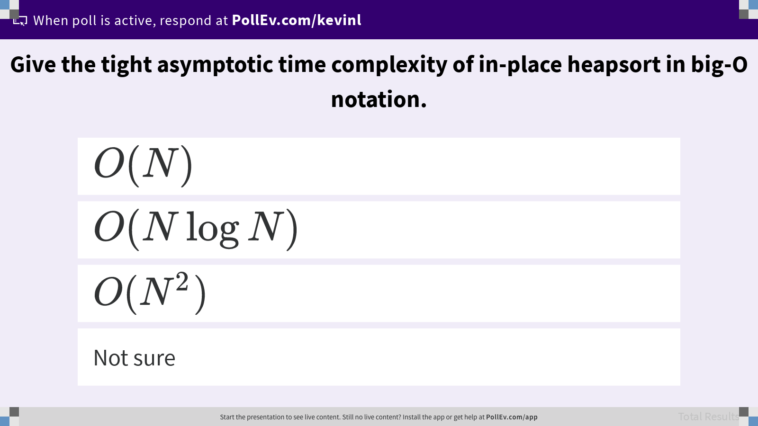
Give the tight asymptotic time complexity of in-place heapsort in big-O notation.

Slide 9
In-place Heapsort Runtime
A
Bottom-up heapification.
Repeat N times:
O(log N). Delete max item from the max-heap.
O(1). Put max item at the end the array.
O(N log N) time overall. Θ(1) space complexity for extra heapification variables, e.g. size.
Bottom-up heapification is N sink operations, each taking no more than O(log N) time, so overall runtime for heapification is O(N log N).
Extra: Show that bottom-up heapification is Θ(N) in the worst case.
Extra: Show heapsort is Θ(N log N) in the worst case.

Slide 10
Heapsort Stability
Q
Bottom-up heapification.
Repeat N times:
Delete max item from the max-heap.
Put max item at the end the array.
Heapsort is not stable. Give an example.

Slide 11
Heapsort Stability
A
Bottom-up heapification.
Repeat N times:
Delete max item from the max-heap.
Put max item at the end the array.
Heapsort is not stable. Give an example.
1_{A}
1_{B}
1_{C}
1_{D}
1_{A}
1_{B}
1_{C}
1_{D}

Slide 12
Heapsort Stability
A
Bottom-up heapification.
Repeat N times:
Delete max item from the max-heap.
Put max item at the end the array.
Heapsort is not stable. Give an example.
1_{D}
1_{B}
1_{C}
1_{D}
1_{B}
1_{C}
1_{A}
Note: Stability doesn’t matter for primitives

Slide 13
Selection Sort Stability
Q
Selection sort. Repeatedly select the smallest remaining item and swap it to its proper index.
Find the smallest item in the array, and swap it with the first item.
Find the next smallest item in the array, and swap it with the next item.
Continue until all items in the array are sorted.
Selection sort is not stable. Give an example.

Slide 14
Selection Sort Stability
A
Selection sort. Repeatedly select the smallest remaining item and swap it to its proper index.
Find the smallest item in the array, and swap it with the first item.
Find the next smallest item in the array, and swap it with the next item.
Continue until all items in the array are sorted.
Selection sort is not stable. Give an example.
2_{A}
2_{B}
2_{C}
1

Slide 15
Selection Sort Stability
A
Selection sort. Repeatedly select the smallest remaining item and swap it to its proper index.
Find the smallest item in the array, and swap it with the first item.
Find the next smallest item in the array, and swap it with the next item.
Continue until all items in the array are sorted.
Selection sort is not stable. Give an example.
1
2_{B}
2_{C}
2_{A}

Slide 16
Sort | Best-Case | Worst-Case | Space | Stable | Notes
Selection Sort | Θ(N²) | Θ(N²) | Θ(1) | No
Heapsort | Θ(N) | Θ(N log N) | Θ(1) | No | Slow in practice.

Slide 17
Merge Sort
Demo
M
~64
N=64
Merge sort.
If array is of size 1, return.
Merge sort the left half.
Merge sort the right half.
Merge the two sorted halves.
Θ(N log N) time complexity.
Θ(N) space complexity.
Stable!
M
M
~32
N=32
~32
N=32
M
M
M
M
~16
16
16
16
16
M
M
~8
8
8
···
···

Slide 18
Sort | Best-Case | Worst-Case | Space | Stable | Notes
Selection Sort | Θ(N²) | Θ(N²) | Θ(1) | No
Heapsort | Θ(N) | Θ(N log N) | Θ(1) | No | Slow in practice.
Merge Sort | Θ(N log N) | Θ(N log N) | Θ(N) | Yes | Faster than heapsort.

Slide 19
Insertion Sort
Demo
Unstable sorting algorithms (heapsort, selection sort) use long-distance swaps.
Merge sort, a stable sort, uses the fact that left-half items come before right-half items.
Idea. Build a sorted subarray (like selection sort) by using left-neighbor swaps for stability.
Insertion sort. Scan from left to right…
If an item is out of order with respect to its left-neighbor, swap left.
Keep on swapping left until the item is in order with respect to its left-neighbor.

Slide 20
Insertion Sort Examples
Purple Item that we’re swapping left.
Black Item swapped with purple item.
Grey Not considered this iteration.
S O R T E X A M P L E
S O R T E X A M P L E (0 swaps)
O S R T E X A M P L E (1 swap )
O R S T E X A M P L E (1 swap )
O R S T E X A M P L E (0 swaps)
E O R S T X A M P L E (4 swaps)
E O R S T X A M P L E (0 swaps)
A E O R S T X M P L E (6 swaps)
A E M O R S T X P L E (5 swaps)
A E M O P R S T X L E (4 swaps)
A E L M O P R S T X E (7 swaps)
A E E L M O P R S T X (8 swaps)
P O T A T O
P O T A T O (0 swaps)
O P T A T O (1 swap )
O P T A T O (0 swaps)
A O P T T O (3 swaps)
A O P T T O (0 swaps)
A O O P T T (3 swaps)
Algorithms (Robert Sedgewick, Kevin Wayne/Princeton)

Slide 21
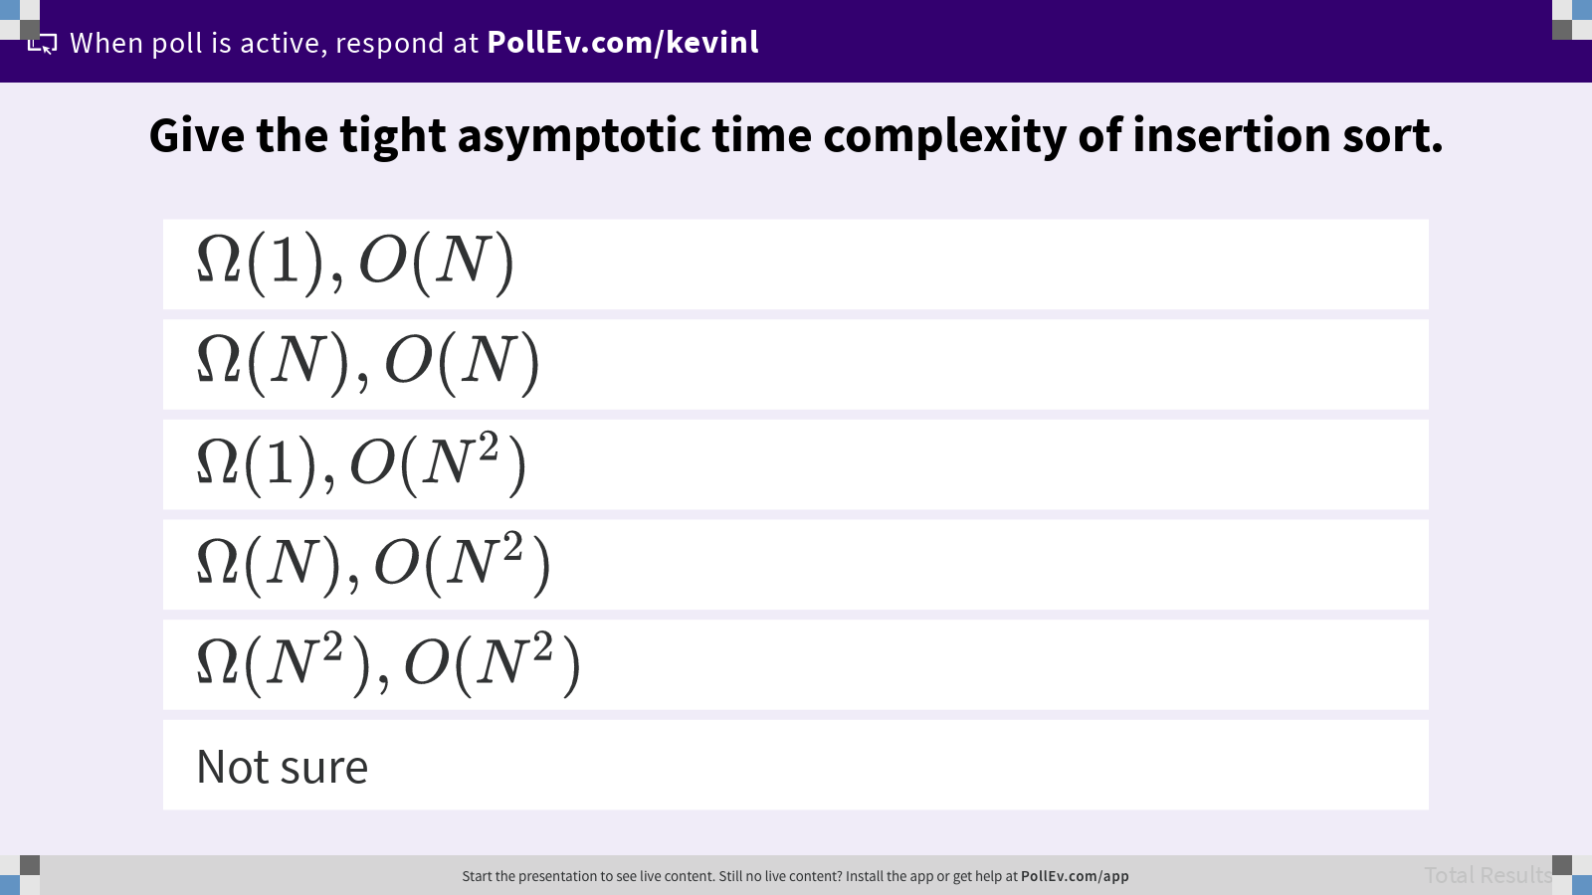
Give the tight asymptotic time complexity of insertion sort.

Slide 22
Quantifying Sortedness
Inversion. A pair of keys that are out of order.
Partially sorted. An array of length N is partially sorted if the number of inversions is in O(N).
Sorted array has 0 inversions.
Sorted subarray with 10 random items at the end has at most 10N + 45 inversions.
Each insertion sort local swap fixes 1 inversion. Θ(N + K) where K is number of inversions.
1 | 2 | 3 | 4 | 5 | 6
T–R | T–P | T–S | R–P | X–P | X–S
A E E L M O T R X P S
COS 226: Elementary Sorts (Robert Sedgewick, Kevin Wayne/Princeton)

Slide 23
Sort | Best-Case | Worst-Case | Space | Stable | Notes
Selection Sort | Θ(N²) | Θ(N²) | Θ(1) | No
Heapsort | Θ(N) | Θ(N log N) | Θ(1) | No | Slow in practice.
Merge Sort | Θ(N log N) | Θ(N log N) | Θ(N) | Yes | Fastest stable sort.
Insertion Sort | Θ(N) | Θ(N²) | Θ(1) | Yes | Best for small or almost sorted inputs.

Slide 24

What is your burning question from today’s lecture?

Slide 25
Optimizing Insertion Sort (Optional)
Idea. Fix multiple inversions at once.
Stride. Instead of comparing adjacent items, compare items that are h apart.
Shellsort. Perform multiple, partial insertion sorts with different strides.
Start with large stride and decrease towards 1, e.g. h = 7, then h = 3, and then h = 1.
Insertion sort is shellsort with one stride, h = 1.
M O R T E X A S P L E
S O R T E X A M P L E
h = 7
h = 3
Algorithms (Robert Sedgewick, Kevin Wayne/Princeton)

Slide 26
Shellsort: Three Iterations of Partial Insertion Sort
h = 7
S O R T E X A M P L E
M O R T E X A S P L E (1 swap, >1 inversions)
M O R T E X A S P L E (0 swaps, 0 inversions)
M O L T E X A S P R E (1 swap, >1 inversions)
M O L E E X A S P R T (1 swap, >1 inversions)
h = 1
A E L E O P M S X R T
A E L E O P M S X R T
A E L E O P M S X R T
A E L E O P M S X R T
A E E L O P M S X R T
A E E L O P M S X R T
A E E L O P M S X R T
A E E L M O P S X R T
A E E L M O P S X R T
A E E L M O P S X R T
A E E L M O P R S X T
A E E L M O P R S T X
h = 3
M O L E E X A S P R T
E O L M E X A S P R T (1 swap, >1 inversions)
E E L M O X A S P R T (1 swap, >1 inversions)
E E L M O X A S P R T (0 swaps, 0 inversions)
A E L E O X M S P R T (2 swaps, >1 inversions)
A E L E O X M S P R T (0 swaps, 0 inversions)
A E L E O P M S X R T (1 swaps, >1 inversions)
A E L E O P M S X R T (0 swaps, 0 inversions)
A E L E O P M S X R T (0 swaps, 0 inversions)
Algorithms (Robert Sedgewick, Kevin Wayne/Princeton)

Slide 27
Sort | Best-Case | Worst-Case | Space | Stable | Notes
Selection Sort | Θ(N²) | Θ(N²) | Θ(1) | No
Heapsort | Θ(N) | Θ(N log N) | Θ(1) | No | Slow in practice.
Merge sort | Θ(N log N) | Θ(N log N) | Θ(N) | Yes | Fastest stable sort.
Insertion Sort | Θ(N) | Θ(N²) | Θ(1) | Yes | Best for small or almost sorted inputs.
Shellsort | Θ(N) | Ω(N log N) | Θ(1) | No | Optional for this course.

